Slide 1

Learning Management system software

Slide 2
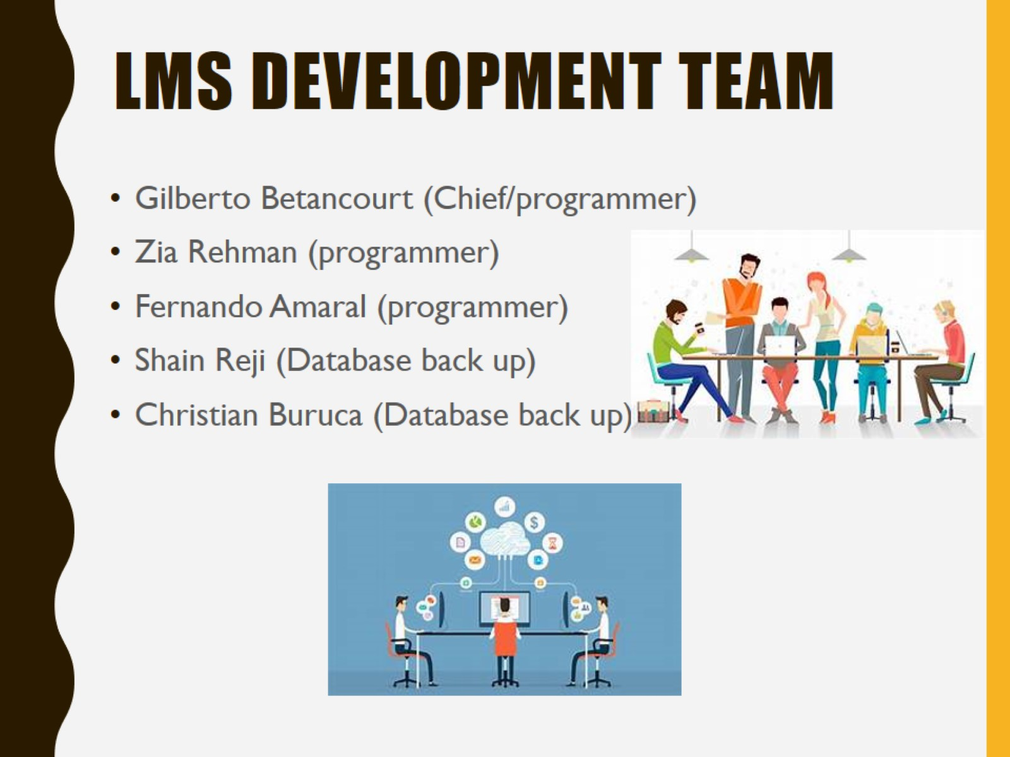
LMS Development Team

Slide 3
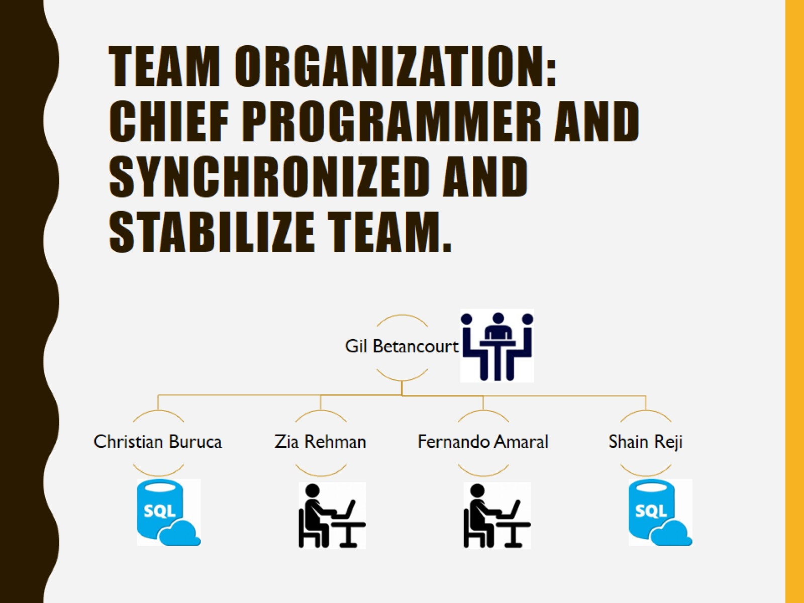
Team organization: Chief programmer and synchronized and stabilize team.

Slide 4
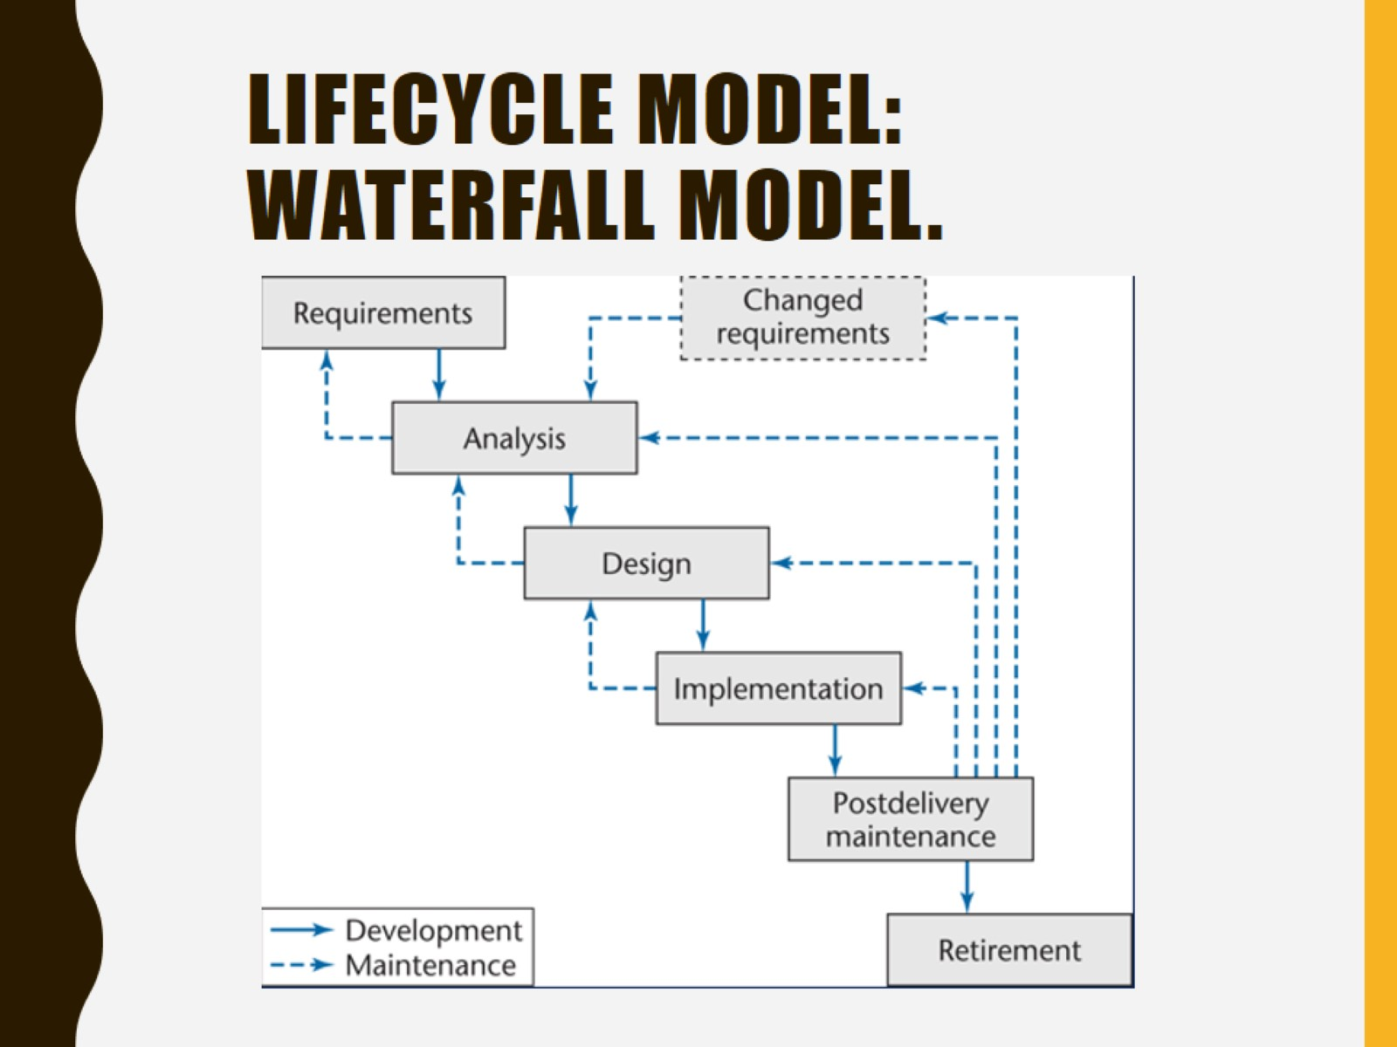
Lifecycle model: Waterfall model.

Slide 5
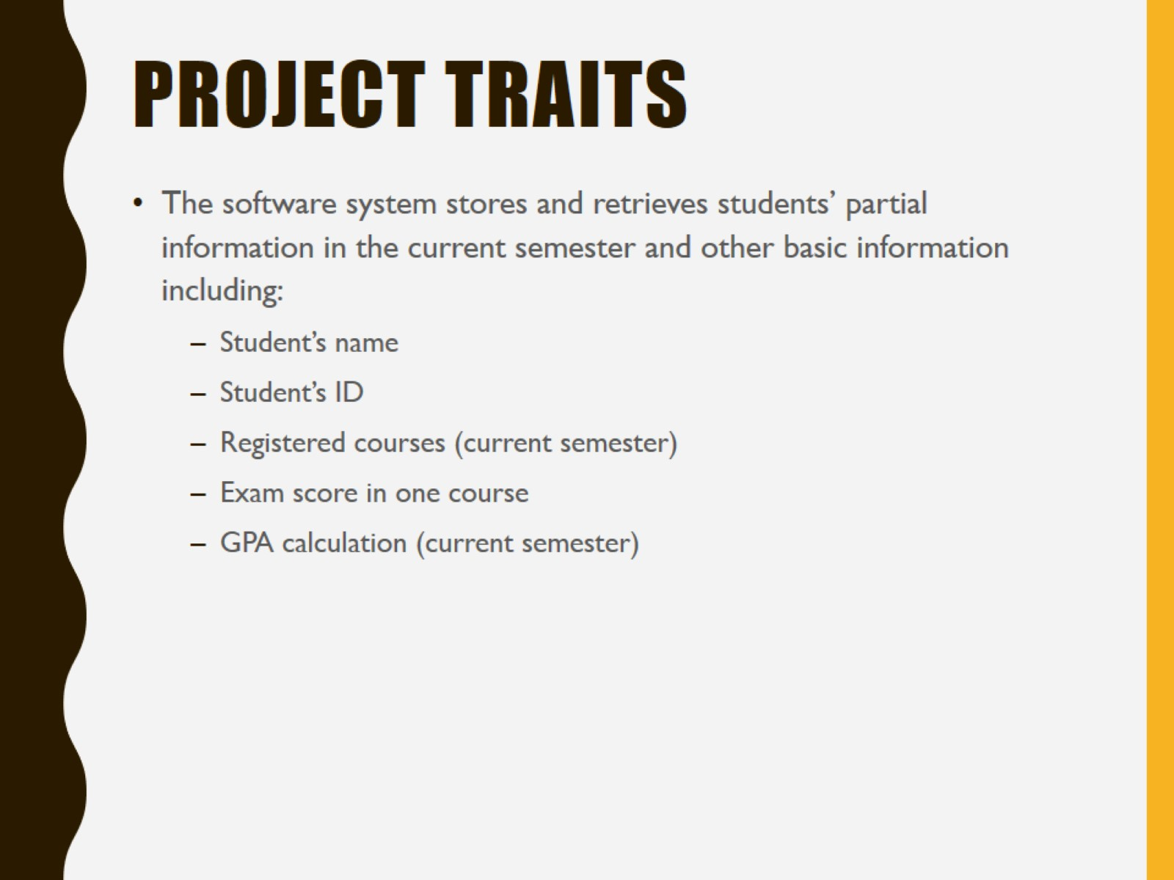
Project traits

Slide 6
Available options
2 types of accessing modes
Administrator
User
Student information management system is managed by an administrator
Administrator able to insert update and monitor the whole process

Slide 7
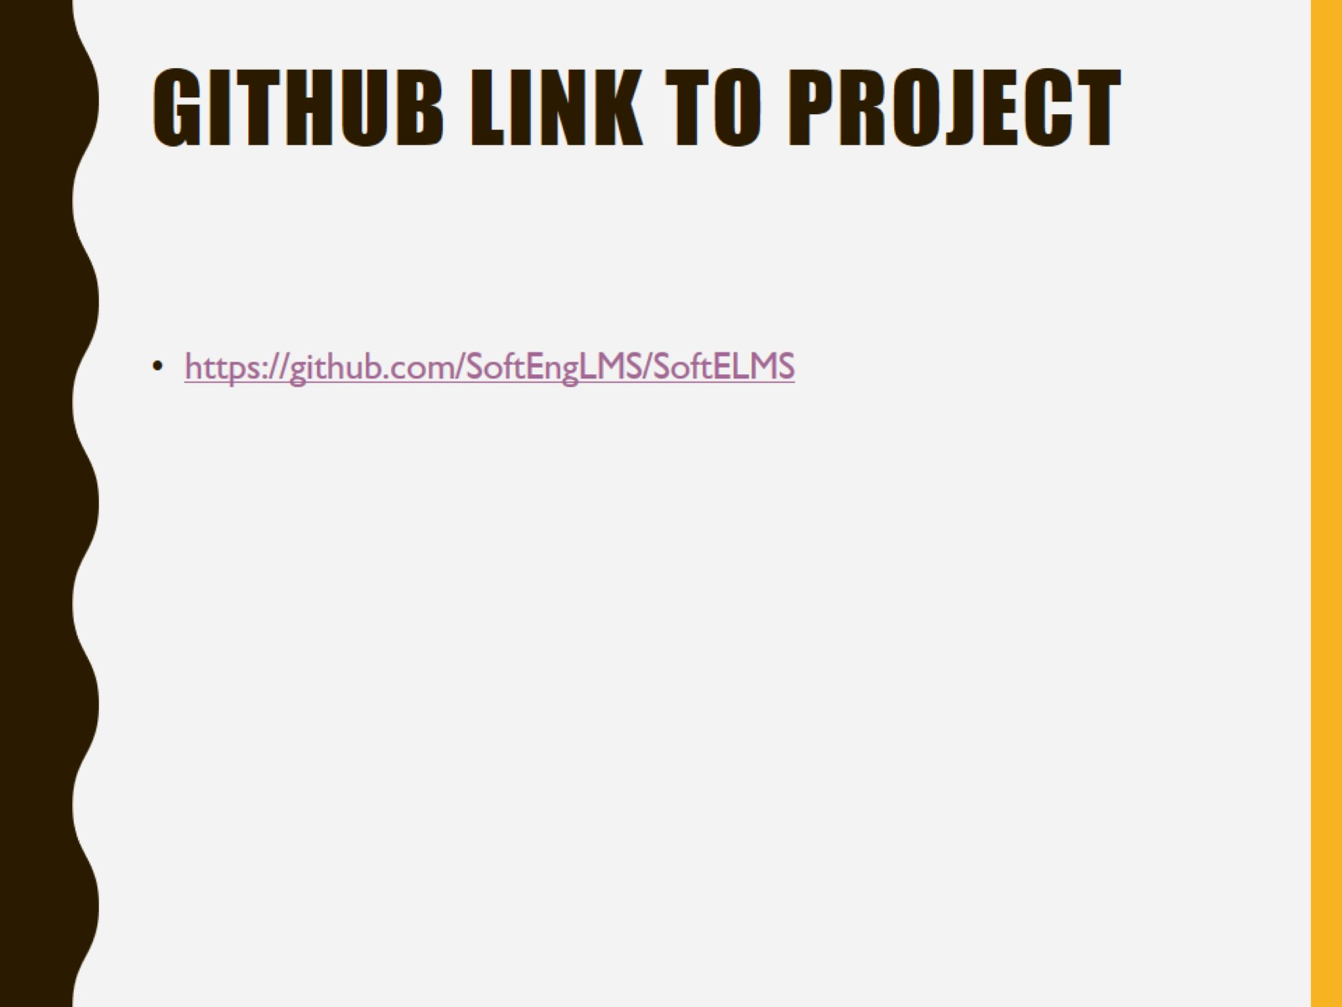
Github link to project

